Slide 1

GAUTAM BUDDHA UNIVERSITY

Slide 2
MINOR PROJECT PRESENTATION TOPIC - Face Mask Detection Minor Project Presentation submitted as a partial requirement for the award of the five year Integrated B.Tech and M.Tech(Computer Science) Under the Supervision of Dr. Neeta Singh Assistant Professor(GBU)
Submitted By: -
Mohammed Hamza(17/ICS/052)
Mohd. Faizan(17/ICS/053)
Piyush Saini(17/ICS/061)
Prashant Gaurav(17/ICS/064)
Prayas Gautam(17/ICS/065)

Slide 3
ACKNOWLEDGEMENT
A minor project is a golden opportunity for learning and self-development. We consider ourselves very lucky and honored to have so many wonderful people lead me through in completion of this project.
We wish to express my indebted gratitude and special thanks to Dr. Neeta Singh, Assistant Professor, Gautam Buddha University, who in spite of being extraordinarily busy with his duties, took time out to hear, guide and keep me on the correct path and allowing me to carry out my Minor Project at their esteemed organization during the training.
We would like to convey my special thanks to Dr. Neeta Singh who devoted her valuable time in carrying out our Project and responding to our queries with utmost patience.
Mohd. Hamza(17/ICS/052)
Mohd. Faizan(17/ICS/053)
Piyush Saini(17/ICS/061)
Prashant Gaurav(17/ICS/064)
Prayas Gautam(17/ICS/065)

Slide 4
TABLE OF CONTENTS
1. Objective
2. Introduction
Artificial Intelligence
Machine learning
Neural Networking
3. Project flow
4. List of Figures
5. Output figures
6. Conclusion

Slide 5
INTRODUCTION ARTIFICIAL INTELLIGENCE
Artificial intelligence (AI), is intelligence demonstrated by machines, unlike the natural intelligence displayed by humans and animals. Leading AI textbooks define the field as the study of "intelligent agents": any device that perceives its environment and takes actions that maximize its chance of successfully achieving its goals. Colloquially, the term "artificial intelligence" is often used to describe machines (or computers) that mimic "cognitive" functions that humans associate with the human mind, such as "learning" and "problem solving". Artificial intelligence is based on the principle that human intelligence can be defined in a way that a machine can easily mimic it and execute tasks, from the most simple to those that are even more complex. The goals of artificial intelligence include learning, reasoning, and perception.

Slide 6
MACHINE LEARNING
Machine learning (ML) is the study of computer algorithms that improve automatically through experience.It is seen as a subset of artificial intelligence. Machine learning algorithms build a model based on sample data, known as "training data", in order to make predictions or decisions without being explicitly programmed to do so. Machine learning algorithms are used in a wide variety of applications, such as email filtering and computer vision, where it is difficult or infeasible to develop conventional algorithms to perform the needed tasks. A subset of machine learning is closely related to computational statistics, which focuses on making predictions using computers; but not all machine learning is statistical learning. The study of mathematical optimization delivers methods, theory and application domains to the field of machine learning. Data mining is a related field of study, focusing on exploratory data analysis through unsupervised learning. In its application across business problems, machine learning is also referred to as predictive analytics.

Slide 7
Machine Learning Approach: Machine learning approaches are traditionally divided into two broad categories, depending on the nature of the "signal" or "feedback" available to the learning system: 1. Supervised learning: The computer is presented with example inputs and their desired outputs, given by a "teacher", and the goal is to learn a general rule that maps inputs to outputs.
2. Unsupervised learning: No labels are given to the learning algorithm, leaving it on its own to find structure in its input. Unsupervised learning can be a goal in itself (discovering hidden patterns in data) or a means towards an end (feature learning).

Slide 8
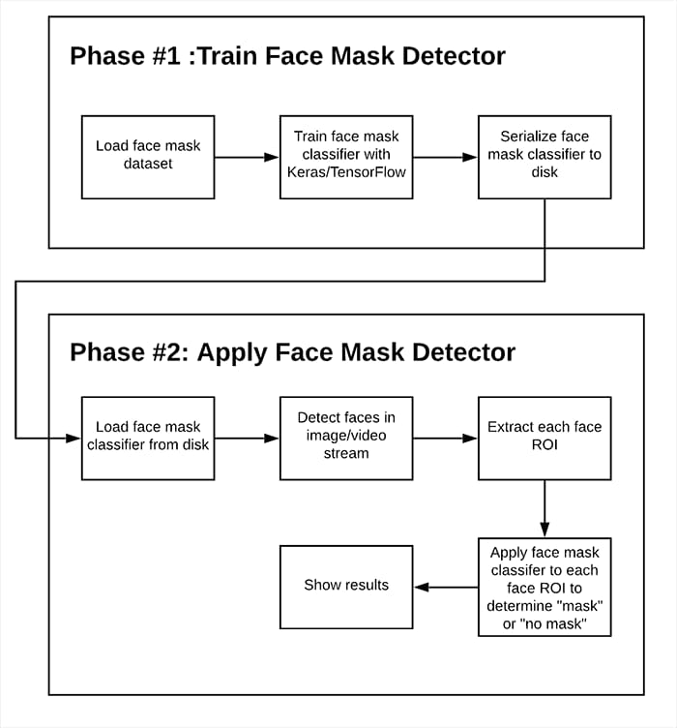

Slide 9
TECHNICAL SUPPORT PYTHON Python is a general-purpose interpreted, interactive, object-oriented, and high-level programming language. It was created by Guido van Rossum during 1985- 1990. Like Perl, Python source code is also available under the GNU General Public License (GPL). Python is a high-level, interpreted, interactive and object-oriented scripting language. Python is designed to be highly readable. It uses English keywords frequently where as other languages use punctuation, and it has fewer syntactical constructions than other languages. XML XML stands for Extensible Mark-up Language. It is a text-based mark-up language derived from Standard Generalized Mark up Language (SGML).XML tags identify the data and are used to store and organize the data, rather than specifying how to display it like HTML tags, which are used to display the data. XML is not going to replace HTML in the near future, but it introduces new possibilities by adopting many successful features of HTML.

Slide 10
OpenCV
OpenCV is a huge open-source library for computer vision, machine learning, and image processing. OpenCV supports a wide variety of programming languages like Python, C++, Java, etc. It can process images and videos to identify objects, faces, or even the handwriting of a human. When it is integrated with various libraries, such as NumPy which is a highly optimized library for numerical operations, then the number of weapons increases in your Arsenal i.e. whatever operations one can do in NumPy can be combined with OpenCV. NumPy
NumPy, which stands for Numerical Python, is a library consisting of multidimensional array objects and a collection of routines for processing those arrays. Using NumPy, mathematical and logical operations on arrays can be performed. This tutorial explains the basics of NumPy such as its architecture and environment. It also discusses the various array functions, types of indexing, etc. An introduction to Matplotlib is also provided. All this is explained with the help of examples for better understanding

Slide 11
Tensorflow
TensorFlow is an open source library for numerical computation and large-scale machine learning. TensorFlow bundles together a slew of machine learning and deep learning (aka neural networking) models and algorithms and makes them useful by way of a common metaphor. TensorFlow is a Python library for fast numerical computing created and released by Google. It is a foundation library that can be used to create Deep Learning models directly or by using wrapper libraries that simplify the process built on top of TensorFlow
TensorFlow is mainly used for: Classification, Perception, Understanding, Discovering, Prediction and Creation.
TensorFlow offers multiple levels of abstraction so you can choose the right one for your needs. Build and train models by using the high-level Keras API, which makes getting started with TensorFlow and machine learning easy.

Slide 12
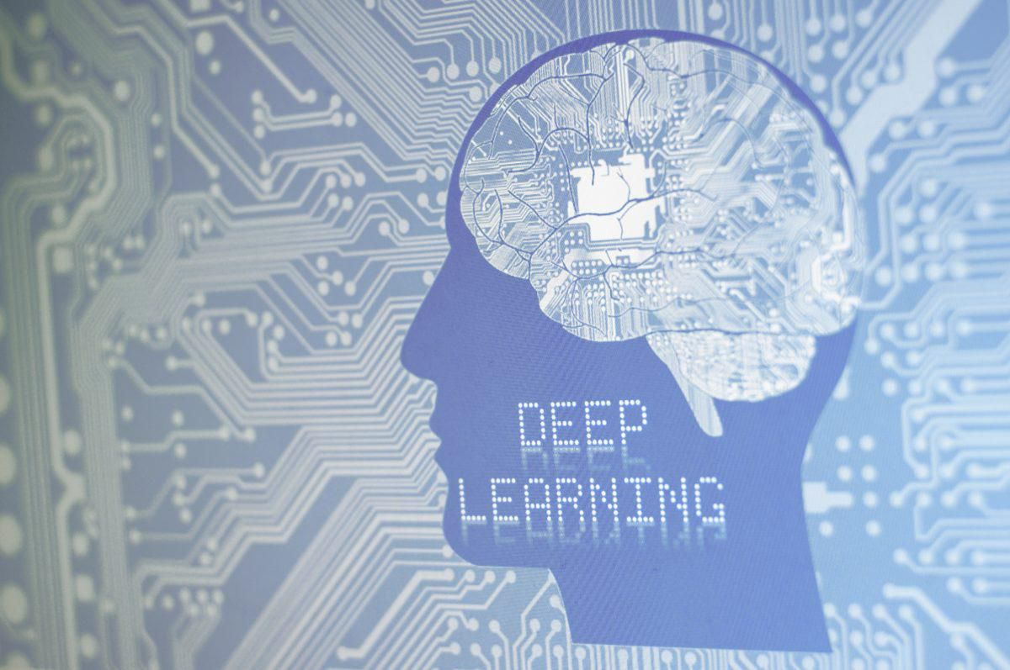
Deep Learning
Deep learning is an AI function that mimics the workings of the human brain in processing data for use in detecting objects, recognizing speech, translating languages, and making decisions. Deep learning AI is able to learn without human supervision, drawing from data that is both unstructured and unlabeled.
Deep learning applications are used in industries from automated driving to medical devices. Automated Driving: Automotive researchers are using deep learning to automatically detect objects such as stop signs and traffic lights. In addition, deep learning is used to detect pedestrians, which helps decrease accidents.

Slide 13
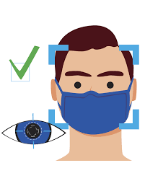
Uses of Face Mask Detection:
Using Face Mask Detection System, Hospitals can monitor if their staff is wearing masks during their shift or not.
Detect people that pass through a security-like camera.
Identify face mask usage and Collect reliable statistics (% people wearing masks).

Slide 14
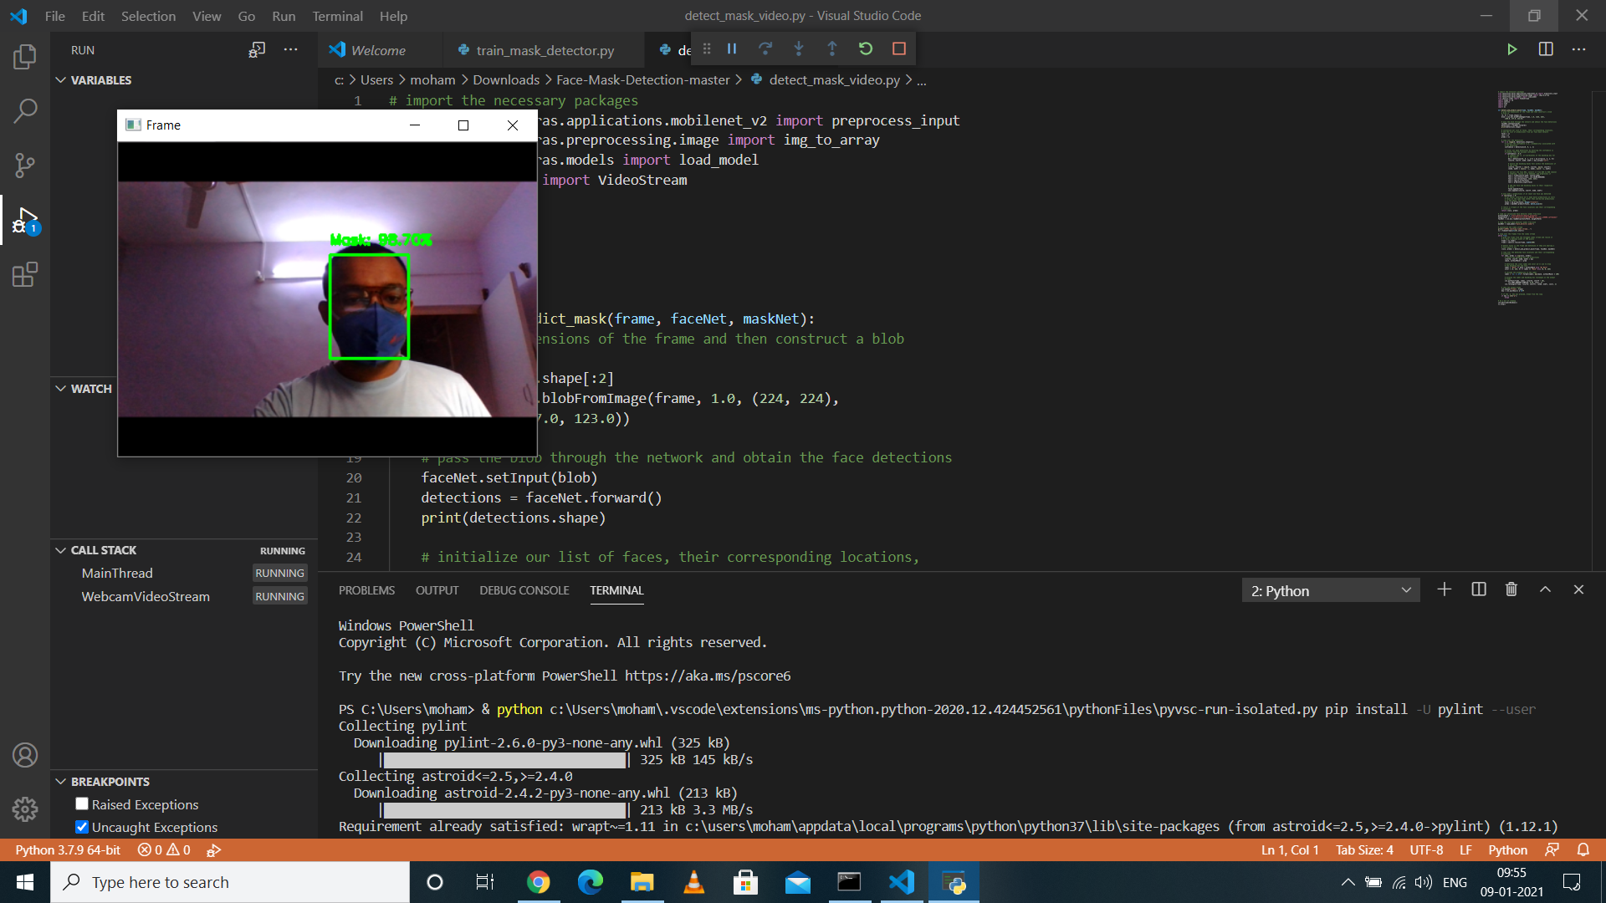

Slide 15
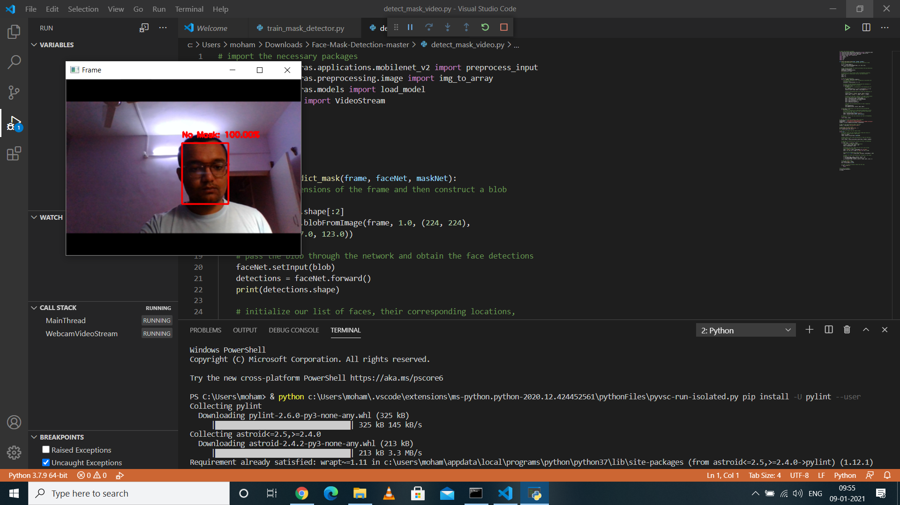

Slide 16
THANK YOU

